Slide 1
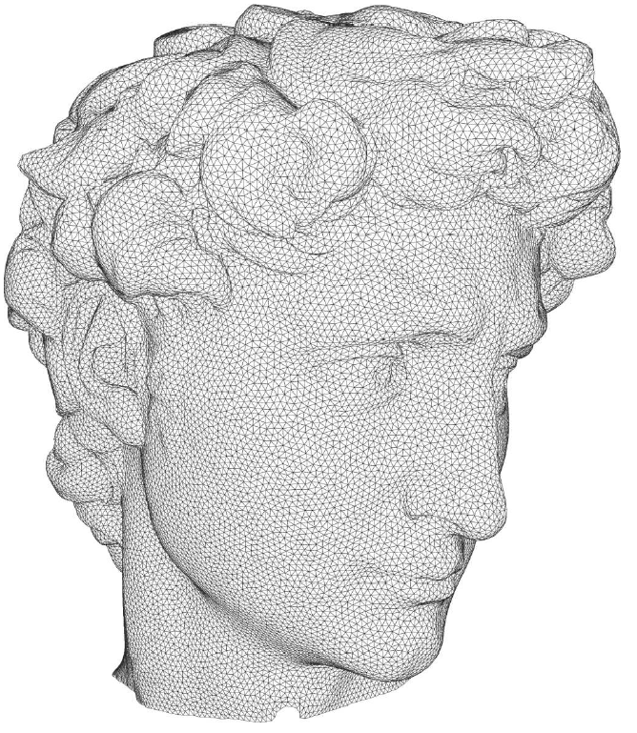
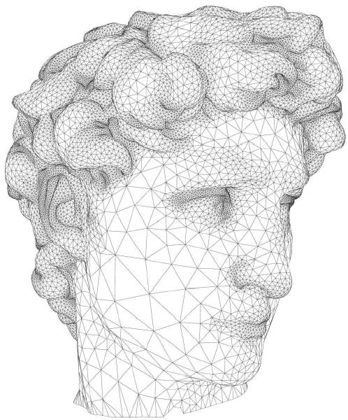
Remeshing

Slide 2
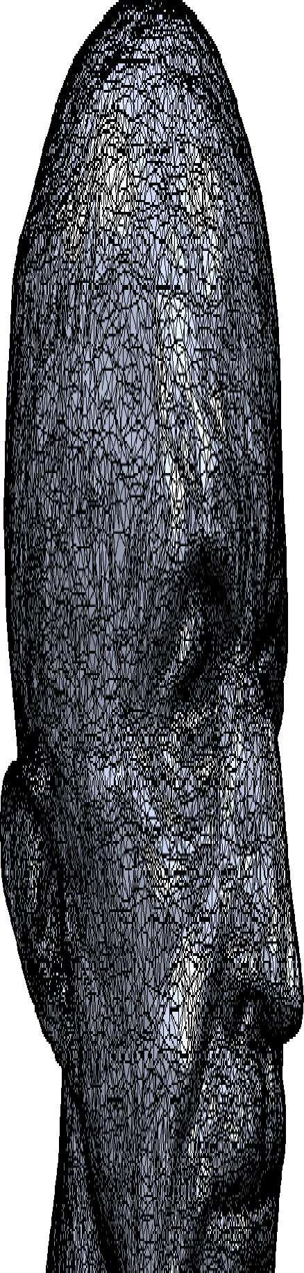
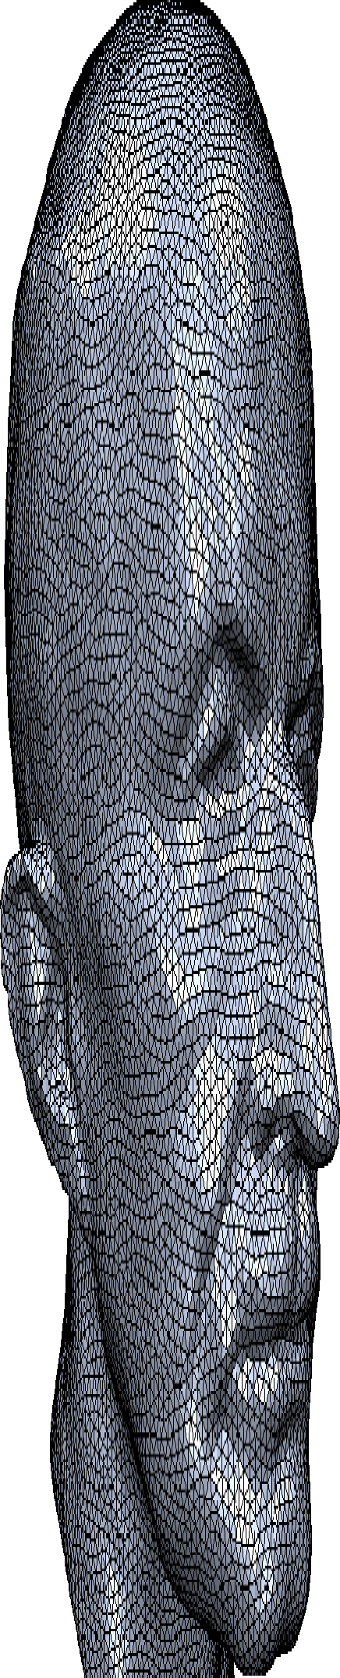
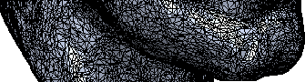

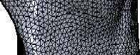


Remeshing
Given a 3D mesh, find a “better” discrete representation of the underlying surface

Slide 3
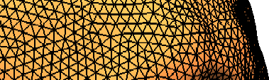
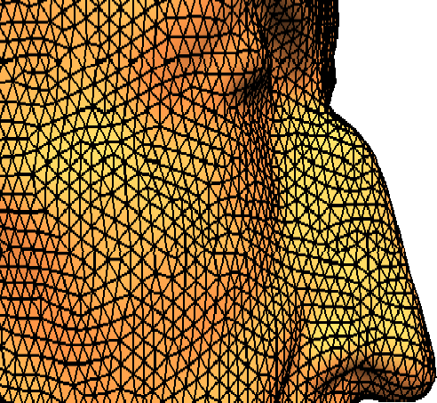
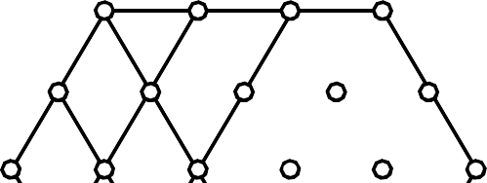
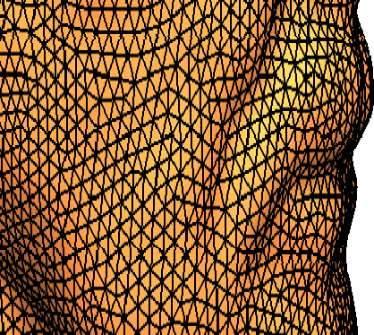

What is a good mesh?
Equal edge lengths 等边长Equilateral triangles 等边三角形
Valence close to 6 度为6

Slide 4





































Local Remeshing Operators
Edge Collapse
Edge Split
Edge Flip
Vertex Shift

Slide 5
Isotropic Remeshing
Specify target edge length L
Compute edge length range [Lmin=4/5L, Lmax=4/3L]
Iterate:
Split edges longer than Lmax
Collapse edges shorter than Lmin
Flip edges to get closer to valence 6
Vertex shift by tangential relaxation
Project vertices onto reference mesh

Slide 6















Edge Flip
Improve valences
Avg. valence is 6 (Euler)
Reduce variation
Optimal valence is
6 for interior vertices
4 for boundary vertices

Slide 7










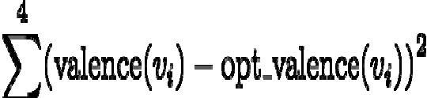



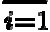
Edge Flip
Improve valences
Avg. valence is 6 (Euler)
Reduce variation
Optimal valence is
Edge
Flip
6 for interior vertices
4 for boundary vertices
-1
Minimize valence excess
+1 +1
-1

Slide 8
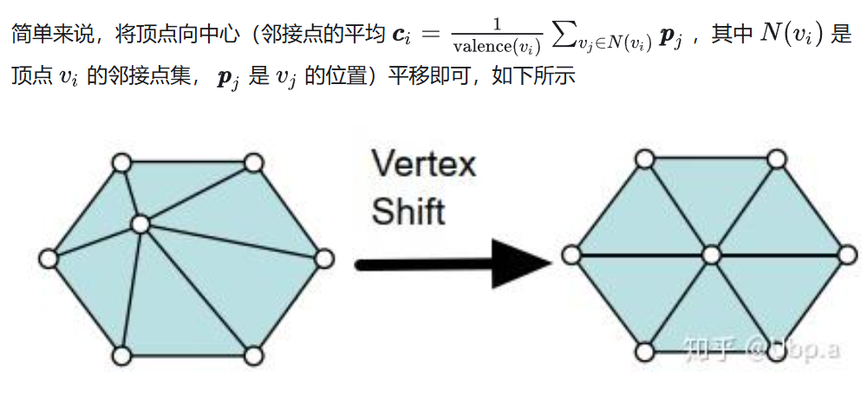
Vertex Shift

Slide 9


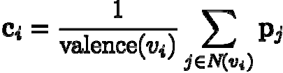
Vertex Shift
Local spring relaxation
Uniform Laplacian smoothing
Bary-center of one-ring neighbors
“ ”

Slide 10









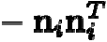
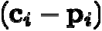
Vertex Shift
Local spring relaxation
Uniform Laplacian smoothing
Bary-center of one-ring neighbors
“ ”
tangent
Keep vertex (approx.) on surface
– Restrict movement to tangent plane
project

Slide 11











Vertex Projection
Project vertices onto original reference mesh
project
Assign position & interpolated normal

Slide 12
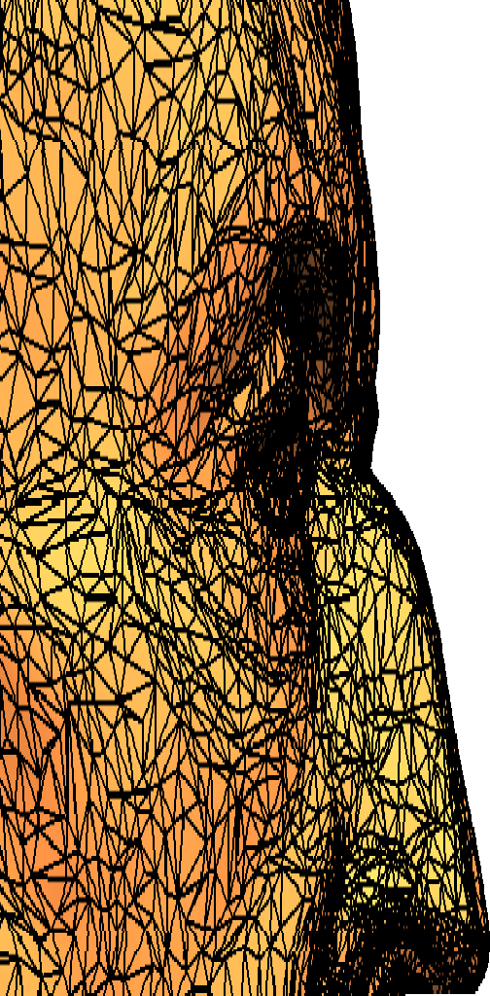
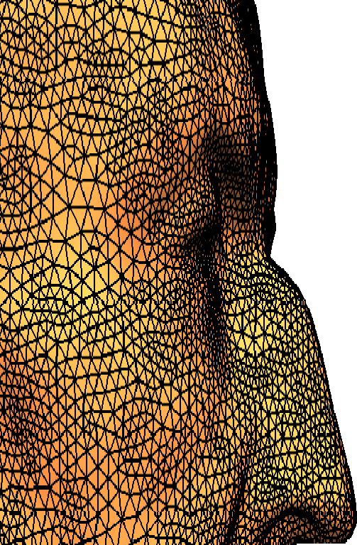
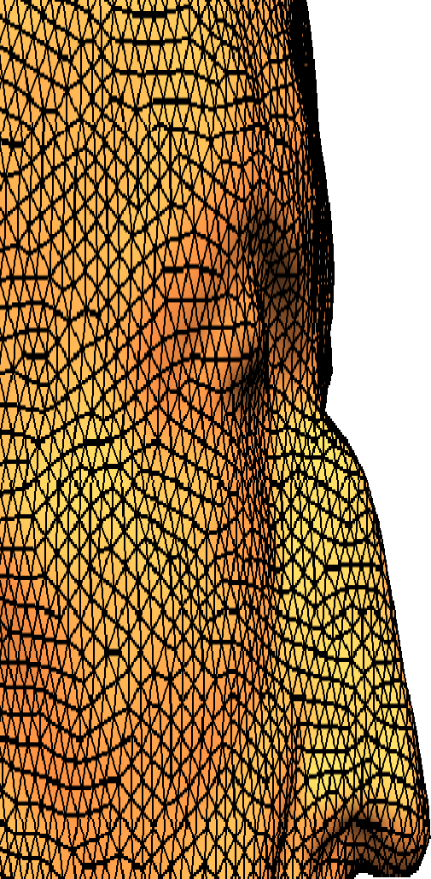
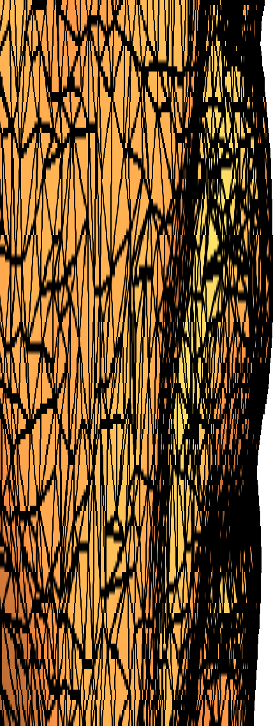
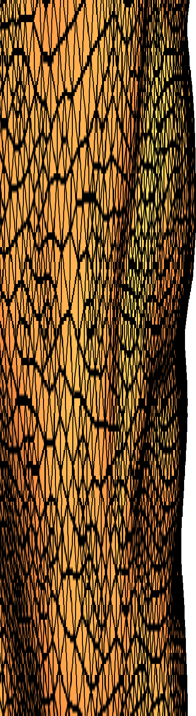
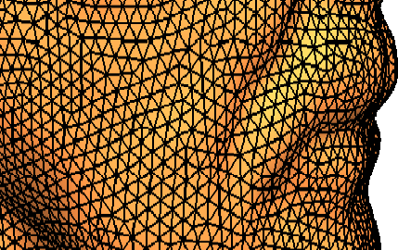
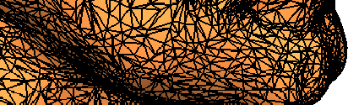


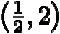
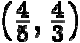
Remeshing Results
Original

